Slide 1
Sprint 2: OverLoad( )
Down2’s production of hExSCAPE

Slide 2
Sprint Goals and Dates
Goals for this sprint are in two sets. First, remaining team members need to complete their learning for C# and Unity. There will also be a mock up Data Flow Diagram for the stand-up meeting to better show the relationships between the different components of hExSCAPE. These goals are slated for 3/7/18.
The second set of goals involve the team member starting their individual sections of trello to work on. They include generating models in Unity, and correctly setting controllers to operate them, and setting up the framework for the hExSCAPE engine. Any generated code will be added to the github as it is produced so that all team members can reference each other’s code generation for added guidance on making new code integrate well with existing code. These goals are slated for 3/22/18.
We are having our stand-up meeting on 3/7/18 as usual to exchange notes on the DFD cards are well as get other to update each other on our progress with Unity familiarity.

Slide 3
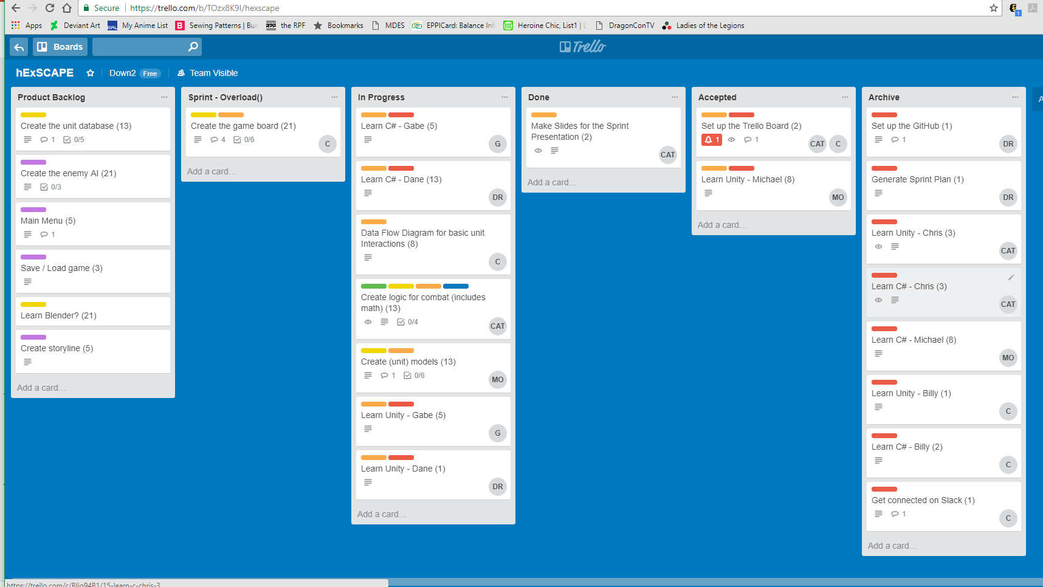
Current snapshot of the Trello board for Sprint 2: Overload.

Slide 4
Release Burndown Chart
This burndown was edited as the team refocused on our new objectives, and have a more realistic estimation of time requirements.
That is why the story point total has increased over the release plan total.

Slide 5
Chris’ Sprint Goals
Generate practice models in the Unity engine
Generate a “bare-bones” or placeholder game engine
This game logic will be written in C#
Expected output will be locations and statuses of objects to be sent to the Unity engine in order to populate the visuals of the game state
Expected time devotion is 10-15 hours over the extended spring break weeks.

Slide 6
Chris’ Accomplishments
I have generated new objects on the game board code provided on the GitHub. It was not pretty but it did exist.
I have written classes in C# to serve as placeholder objects for game states.
I was able to devote closer to five hours on these tasks.

Slide 7
Dane’s Sprint Goals
Learn C# using Microsoft Virtual Academy.
Learn Unity.
Write code that seems applicable to a 3D game.
I expect to understand classes in C# and understand the menus in the Unity interface. I plan to spend approximately 10 hours.

Slide 8
Dane’s Accomplishments
I know C# functionally enough to write statements.
I know Unity interface layout and what a couple of the features do like applying physics to objects.
I generated functions that allow switching between game objects, functions that resize objects and functions that attach significance to places on the board.
*I did not anticipate to write code, but the parts that I did write seem valuable to our game. I only was able to squeeze out 7 hours, but they were high quality hours.

Slide 9
Billy’s Sprint Goals
Generate Data Flow Diagrams in order to show what kinds of data will be passed between the different objects on the program.
Outline possible component descriptions of major classes in order to better outline the functions required in the main program.
Planned time expenditure during Sprint 2: Overload will be 8 hours.

Slide 10
Billy’s Accomplishments
Generated several diagrams showcasing data income and outgo between classes.
Wrote several component descriptions detailing variable and functions of the unit class, board class, and others.
Actual time spent on Sprint 2 this week was closer to 12-16 hours. Estimation of time required was lower than reality.

Slide 11
Michael’s Sprint Goals
Complete C# tutorials.
Complete Unity tutorials.
Generate models to be places in the Unity engine and place them on the game board.
I expect to devote about 10 hours to these goals during this sprint.

Slide 12
Michael’s Accomplishments
Completed the recommended tutorials in C#. I feel comfortable writing code in this language.
Generated an object in the Unity engine. I was able to take this knowledge and begin the work needed to make simple models for future units to be placed on the game board.
I spent about ten hours during this week on these tasks.

Slide 13
Gabriel’s Sprint Goals
Complete C# tutorials.
Complete Unity tutorials.
I expect to devote about 10 hours to these goals during this sprint.

Slide 14
Gabriel’s Accomplishments
Completed C# tutorials. I feel confident in my knowledge of C#.
Completed Unity tutorials. I feel prepared to contribute code to the project.
I spent about ten hours working on this.

Slide 15
Sprint 2: Overload( )
This sprint marks the conclusion of the learning phase and the beginning of the creation phase for our group.
Now that we are familiar with the development environment, our team is ready to generate software for this project.

